Slide 1
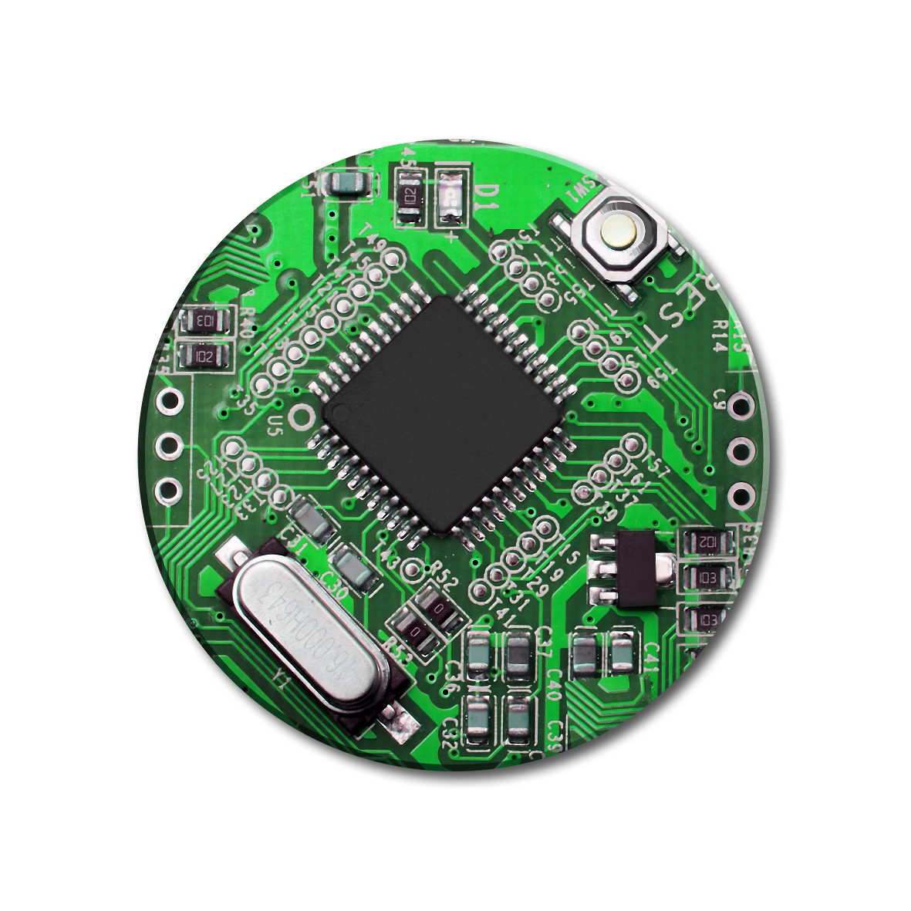
Transforming Non-ERP application leveraging Open Source technologies
2/26/2018

Slide 2


Today’s pain points
A $50bn global organization, operating in 46 countries worldwide, has a number of technology pain points in maintaining their non-ERP footprint of applications
Mergers & Acquisitions
Organization in a constant state of acquisitions / divestitures
Frequent change / addition to application footprint
ERP leveraged Adopt & Go, Non-ERP approach was not consistent
Operating Cost
Operating Cost for Non-ERP growing faster than ERP
Higher technical debt due to acquisition of applications that are not well architected
Growing licensing cost a concern
Inconsistent UI / Experience
Inconsistent UI across applications
Multiple logins for different applications (no Single Sign-on)
No analytics to improve user experience
Frequent outages
Weekly releases of features needed weekly down time (globally)
Code deployment (including emergencies) involved application down time
Unable to proactively monitor the entire foot print of services

Slide 3
Our approach to resolve
As the chosen application services vendor, we proposed a number of improvements to enable the organization to become technically nimble for a group of applications which has the highest impact
Mergers & Acquisitions
Micro services based platform architecture, allowing easy addition / subtraction of functions
Adopt & Go method for Non-ERP
Operating Cost
Open Source first approach to lower licensing cost
Minimal instances of licensed products
Consistent architecture for the entire foot print
Inconsistent UI / Experience
Atomic design based approach (implemented using open source UI tech)
SSO across the entire Non-ERP footprint
Open-source based user analytics for the entire application foot print
Frequent outages
Micro-services based architecture, allows for component based deployment
Dev-Ops using open-source tools for automated deployment process
Advanced log management / alerting mechanisms

Slide 4
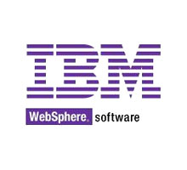

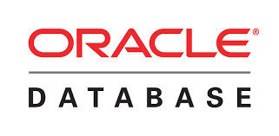



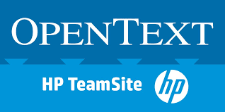





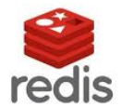





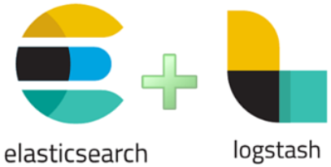






Planned end state for the applications
Current application (in scope) footprint
After transformation
Portal
Content Management System & UI
Content Delivery Network & Accelerators
Webservices / Microservices
Testing
Enterprise Search & Log management
SSO
Web Analytics
Licensed Product
Existing perpetual licenses
Open Source Licenses

